Slide 1
Installation Guide
(IDE – SQL Explorer Plug-in 3.5.0 RC8 on Eclipse 3.5)
2009. 07.20
CODELABOR
Shin Sang Jae (codelabor@gmail.com)

Slide 2
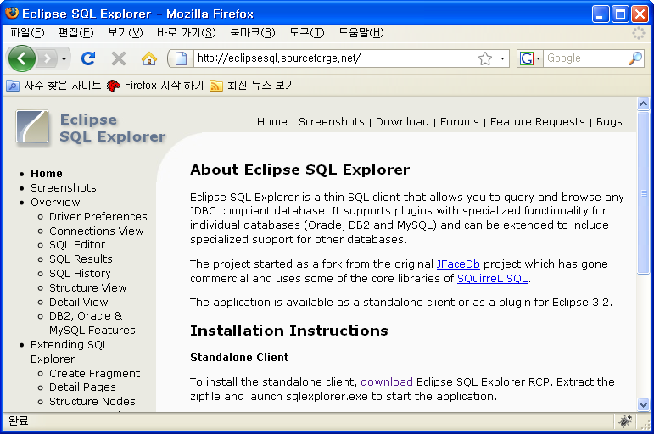
SQL Explorer
Site
Officical Site: http://eclipsesql.sourceforge.net/

Slide 3
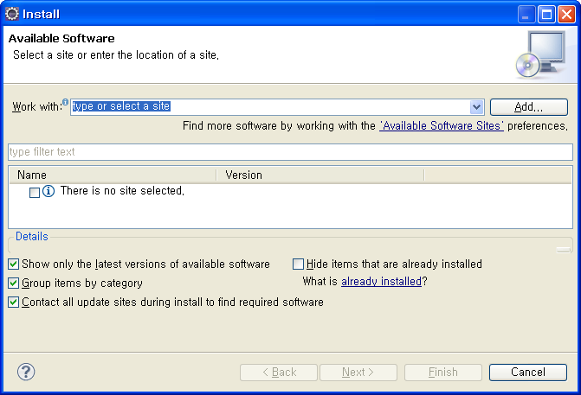
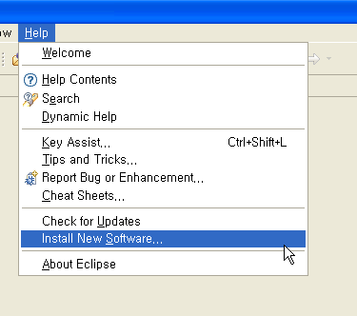
SQL Explorer
Install
Menu
  Help > Install New Software...
Install Window
  Work With: > Add

Slide 4
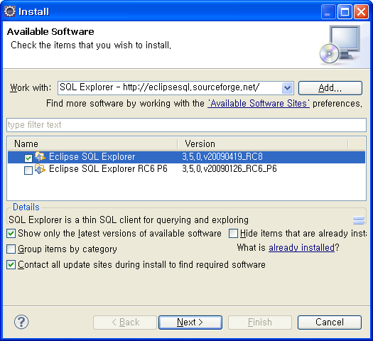
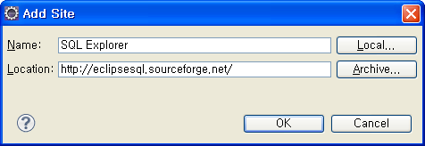
SQL Explorer
Add Site
Add Site Windows
  Name: SQL Explorer
  Location: http://eclipsesql.sourceforge.net/
  Uncheck Group items by category
  Check Eclipse SQL Explorer (RC8)

Slide 5
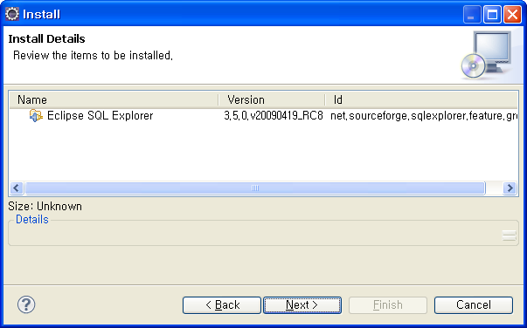
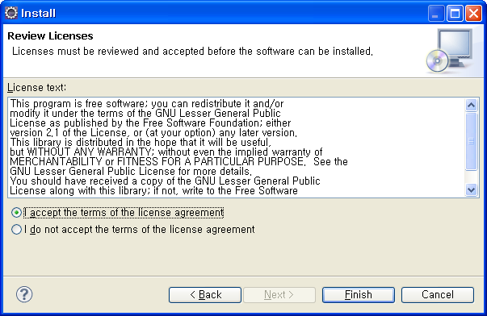
SQL Explorer
Install
Install Details Window
Accept the terms of the license agreements

Slide 6
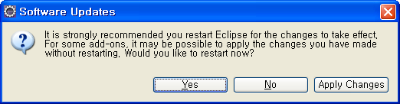
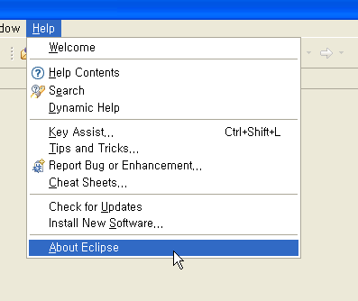
SQL Explorer
Software Updates
Software Updates Window
  Restart
Menu
  Help > About Eclipse

Slide 7
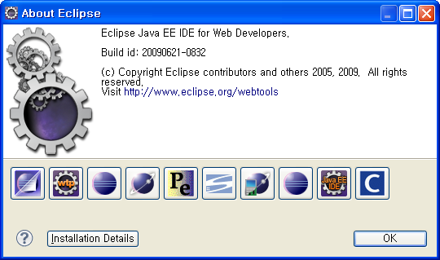
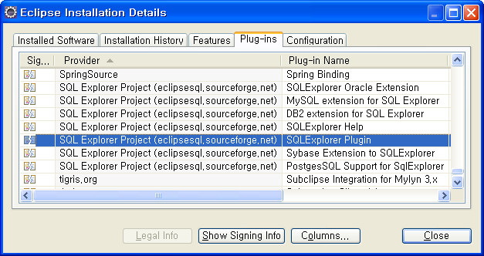
SQL Explorer
Software Updates
About Eclipse Window
  Install Details
Eclipse Installation Details Window
  Plug-ins

